Slide 1

Team Details
Team Name:
Problem Statement:

Slide 2
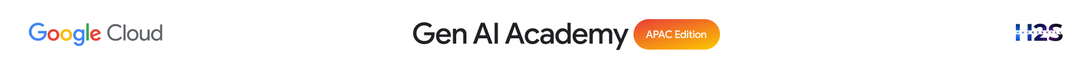
Brief about the idea
Type here…

Slide 3
Your solution should be able to explain the following:
How did you approach the common problem statement and translate it into a working solution using Google Cloud technologies (e.g., BigQuery, ADK, Vertex AI, Gemini, etc.) while ensuring the hackathon's core requirements are met? If you selected the NVIDIA problem statement, also explain how NVIDIA technologies were integrated into your solution.
What real-world problem does your solution address, and what practical impact does it create for users, organizations, or communities??
What is the core architecture or workflow behind your solution, and how does it transform data into actionable insights or intelligent decisions?
Type here…

Slide 4
Opportunities
How different is it from any of the other existing ideas?
USP of the proposed solution
Type here…

Slide 5
List of features offered by the solution
Type here…

Slide 6
Process flow diagram or Use-case diagram
Type here…

Slide 7
Wireframes/Mock diagrams of the proposed solution
Type here…

Slide 8
Architecture diagram of the proposed solution:
Type here…

Slide 9
Technologies / Google / Nvidia Services used in the solution (Why did you choose your specific AI stack and system design, and how does it support scalability and real-world deployment?)
Type here…
Notes:
All solutions must leverage Google Cloud technologies. NVIDIA technologies should be included by teams that have selected the NVIDIA problem statement.

Slide 10
Snapshots of the prototype
Type here…

Slide 11
Improvements done during prototype refinement phase
Type here…

Slide 12


